Slide 1
Photo Editor App
Miniproject by:
Karishma Bairi (A-15)
Shweta Kaware (A-06)
Abhishek Eitkar (A-14)
Under guidance of Prof. Vishwajeet Gaikwad

Slide 2
Table of Contents
Introduction
Problem Statement
Aim & Objective
Implementation
Conclusion
References

Slide 3
INTRODUCTION
Pico App is the convenient app for image editing.
Pico App provides an easy-to-use user interface which allows you to quickly edit images.
Pico App reduces the time and development efforts required to customize your graphical content, saving your time and money.
The huge advantage of Pico App is that, unlike other available tools, the actual digital image processing takes place on the client mobile before uploading it to the server.
Intuitive and easy-to-use, Pico App lets you edit images faster.
The user can open an image from the mobile and start editing directly.
When editing is finished the file can be saved locally. The user can select the file type, set parameters and the file is saved.

Slide 4
Problem statement
Generally problems in photo editing apps is several ads, charges for using features or filters, charges for downloading the image.
So the problem we solved here is by keeping it ad free and using features for free.

Slide 5
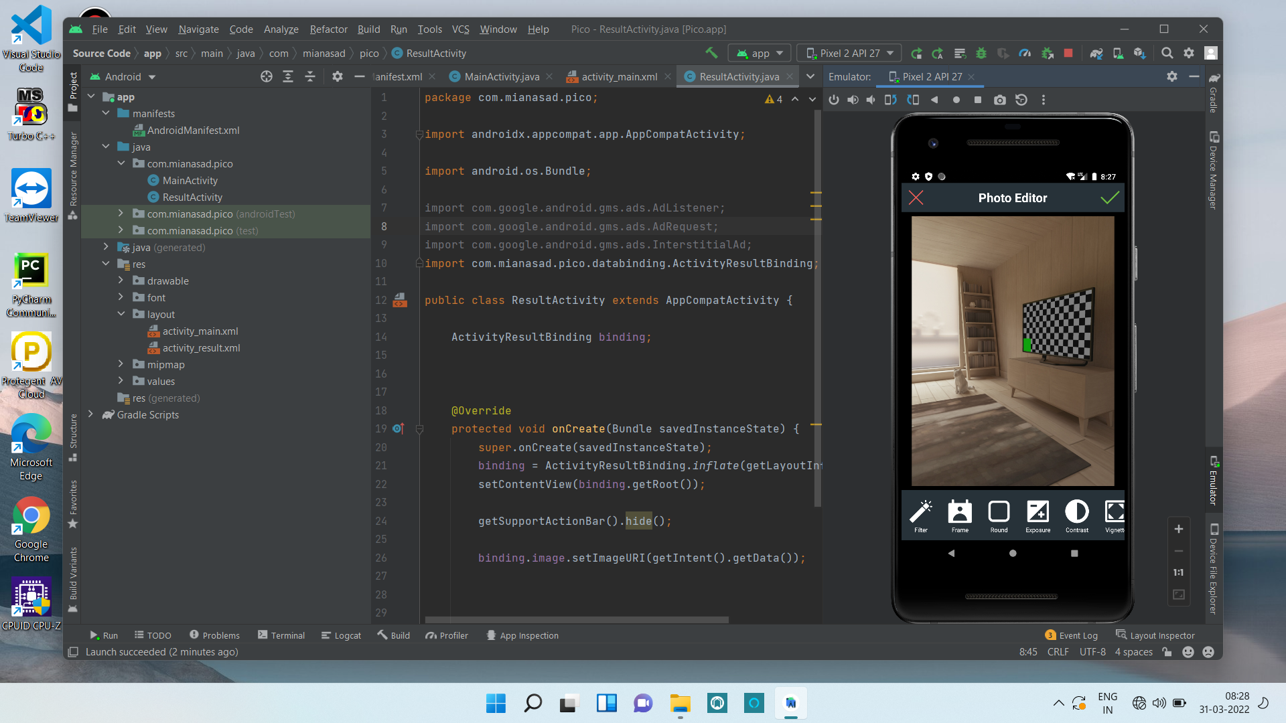
IMplementation

Slide 6
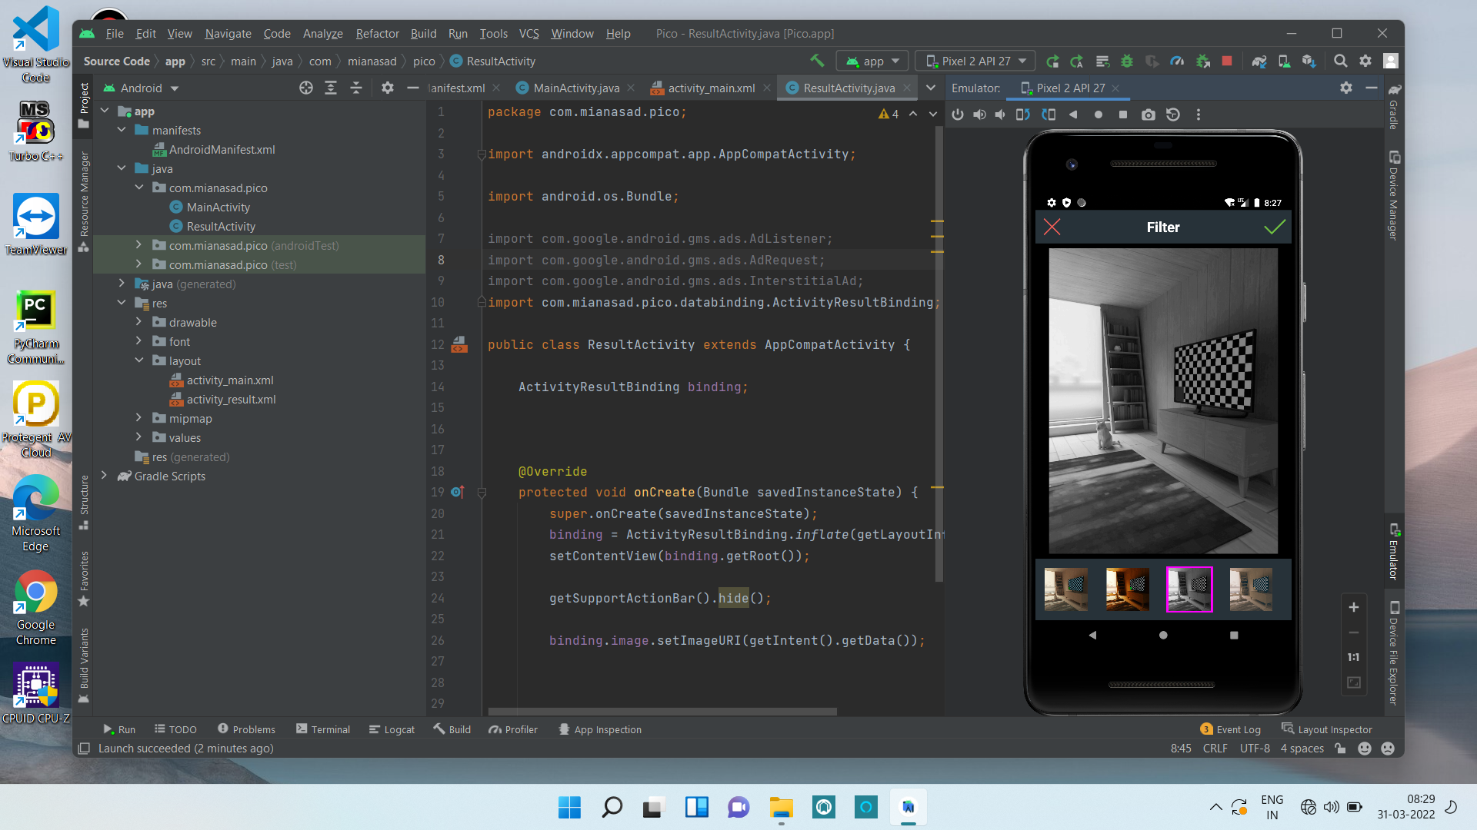

Slide 7
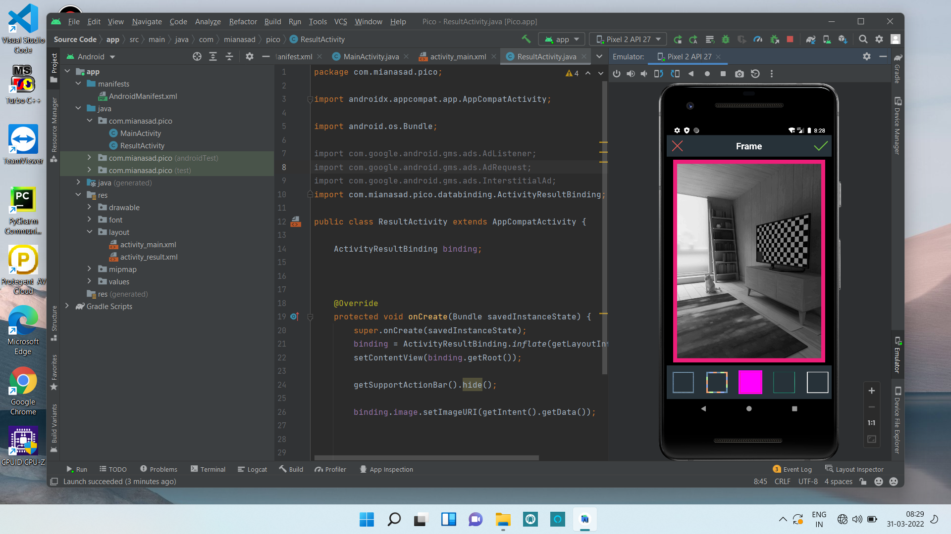

Slide 8
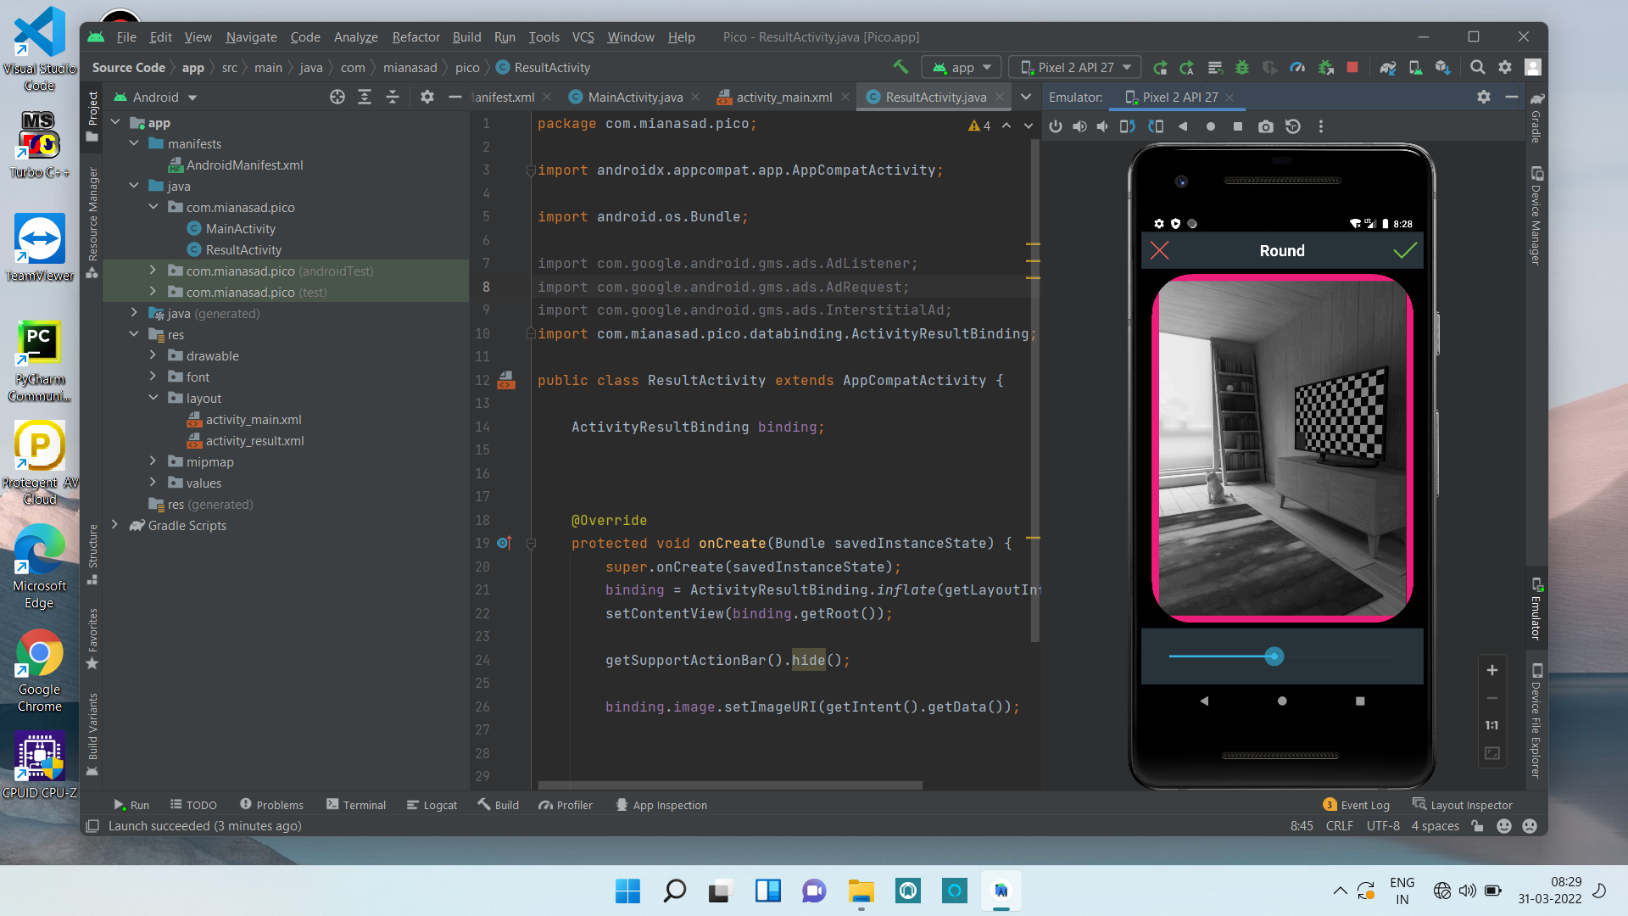

Slide 9


Slide 10
Conclusion
Pico app benefits user with free tools.
Pico app helps you easily use all the features free of cost.
Through Pico app one can edit all types of images .
Also one can click picture and edit it in the Pico app itself.
Also this app is ad free.
User can edit images using all the features such as filter, colors, frames, etc.

Slide 11
References
https://www.kashipara.com/project/java/3475/photoeditor
https://pdfcoffee.com/a-project-report-alfa-image-editor-in-fulfillment-for-the-award-of-the-degree-of-bachelor-of-computer-application-pdf-free.html
http://catalogue.pearsoned.ca/assets/hip/us/hip_us_pearsonhighered/samplechapter/0321168828.pdf

